Slide 1

Relational Model – Data Models
Gerry Guinane
Limerick Institute of Technology
Relational Model Lecture 01

Slide 2
Learning outcomes
Learning outcomes – the student will be able to
Describe 3 major data storage models of DBMS’s
Using an example – represent data in all three forms

Slide 3
Database models
DBMS’s are generally classified according to the models they use to store data
There are 3 major models
Hierarchical
Network
Relational

Slide 4
Hierarchical DBMS
Data in hierarchical form is viewed as consisting of a series of independent trees
Hierarchical DBMS’s are good for 1:many but not for many:many relationships
STUDENT
923456 | John Smith | Castletroy | Limerick
RESULTS
SD401 | 23 | 49 | 72
SD402 | 23 | 49 | 72

Slide 5
Network DBMS
Network DBMS store data as a network of data items
923456 | John Smith | Castletroy | Limerick
SD402 | 23 | 49 | 72
SD401 | 23 | 49 | 72

Slide 6
Relational DBMS
Relations are represented by common data values in tables
No pointers or links

Slide 7
Relational DBMS Example
Students
923456 | John Smith | Castletroy | Limerick
923867 | Mary Burke | Castleconnel | Limerick
853456 | Peter Jones | Oranmore | Galway
458567 | Albert Ahern | Drumcondra | Dublin
Results
SD402 | 23 | 49 | 72 | 923456
SD401 | 23 | 49 | 72 | 923456
SD401 | 17 | 51 | 68 | 853456
SD401 | 21 | 45 | 66 | 458567
Records in tables
are linked by COMMON
data values

Slide 8
L6 Class Example Projects and Parts DB

Slide 9
Project & Parts DB
A DB is to be established to store information about projects involving assembly of several parts at a location
For each part the DB records
PART_NO, PART_NAME, WEIGHT
For each Project
PROJ_NR, MANAGER, LOCATION

Slide 10
There are 3 Projects
Proj_Nr 418 Managed by Bob in Dublin
Proj_Nr 426 Managed by Mary in Athlone
Proj_Nr 431 Managed by Joan in Galway

Slide 11
And 3 types of part
Part_Nr 42 Nuts, weight 420g
Part_Nr 46 Bolts, weight 560g
Part_Nr 51 Nails, weight 240g

Slide 12
Parts required by each project
Dublin project requires 2000 nuts & bolts
Athlone project requires 10000 nails
Galway project requires 5000 nuts and bolts

Slide 13
Heirarchical DB
Relationship between data is contained in the heirarchical structure – lets assume ‘projects’ are the top of the heirarchy…

Slide 14
Hierarchical DB - Parts
ProjectsDB
418 Bob Dublin
426 Mary Athlone
431 Joan Galway

Slide 15
Hierarchical DB - Parts
ProjectsDB
418 Bob Dublin
426 Mary Athlone
42 Nut 420 2000
46 Bolt 560 2000
431 Joan Galway

Slide 16
Hierarchical DB - Parts
ProjectsDB
418 Bob Dublin
426 Mary Athlone
51 Nail 240 10000
42 Nut 420 2000
46 Bolt 560 2000
431 Joan Galway
46 Bolt 560 5000
42 Nut 420 5000

Slide 17
Example Hierarchical DB
Currently the most widely used hierarchical databases are
IMS developed by IBM and
Windows Registry by Microsoft.
IMS - http://www-01.ibm.com/software/data/ims/index.html

Slide 18
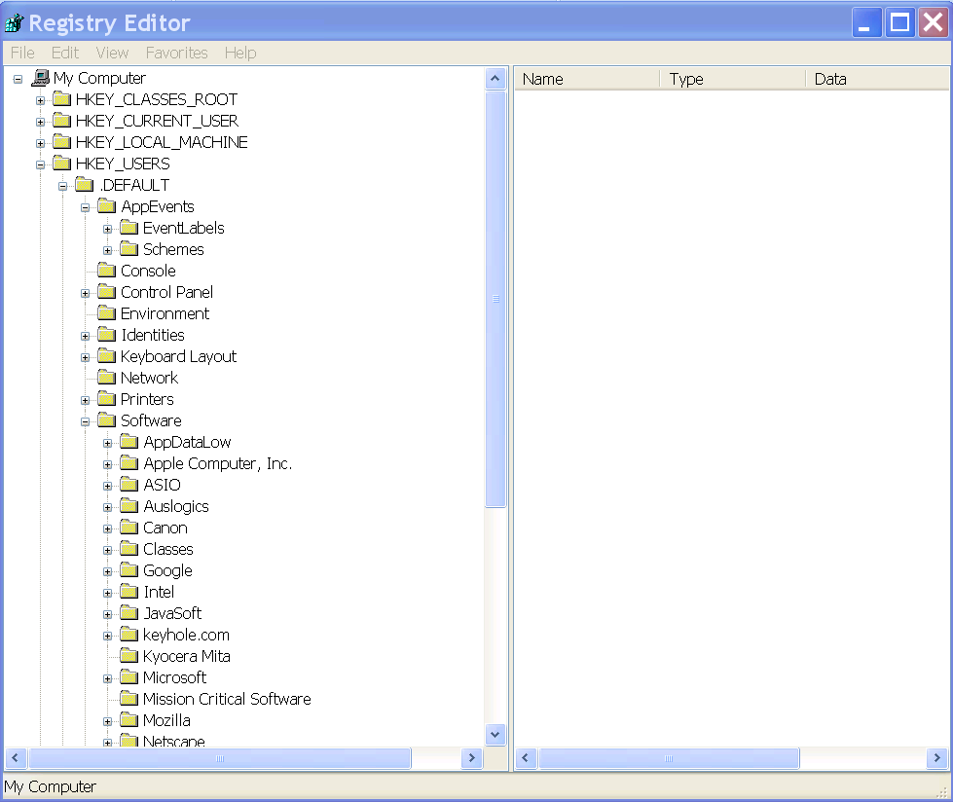
Windows Registry
regedit

Slide 19
Network DB
The relationship between data is contained in pointers

Slide 20
Projects..
418 Bob Dublin
431 Joan Galway
426 Mary Athlone

Slide 21
Projects..
418 Bob Dublin
431 Joan Galway
426 Mary Athlone
Parts..
46 Bolt 560
42 Nut 420
51 Nail 240

Slide 22
418 Bob Dublin
Take project 418 for example..
It requires 2000 nuts and 2000 bolts
46 Bolt 560
42 Nut 420
51 Nail 240

Slide 23
418 Bob Dublin
pointer
2000
2000
46 Bolt 560
42 Nut 420
51 Nail 240

Slide 24
418 Bob Dublin
2000
2000
46 Bolt 560
42 Nut 420
51 Nail 240

Slide 25
418 Bob Dublin
431 Joan Galway
2000
2000
46 Bolt 560
42 Nut 420
51 Nail 240

Slide 26
418 Bob Dublin
431 Joan Galway
5000
5000
2000
2000
46 Bolt 560
42 Nut 420
51 Nail 240

Slide 27
418 Bob Dublin
431 Joan Galway
2000
5000
5000
2000
42 Nut 420
46 Bolt 560
51 Nail 240

Slide 28
418 Bob Dublin
431 Joan Galway
2000
5000
5000
2000
42 Nut 420
46 Bolt 560
51 Nail 240

Slide 29
418 Bob Dublin
431 Joan Galway
2000
5000
5000
2000
42 Nut 420
46 Bolt 560
51 Nail 240
426 Mary Athlone

Slide 30
418 Bob Dublin
431 Joan Galway
2000
5000
5000
2000
42 Nut 420
46 Bolt 560
51 Nail 240
10000
426 Mary Athlone

Slide 31
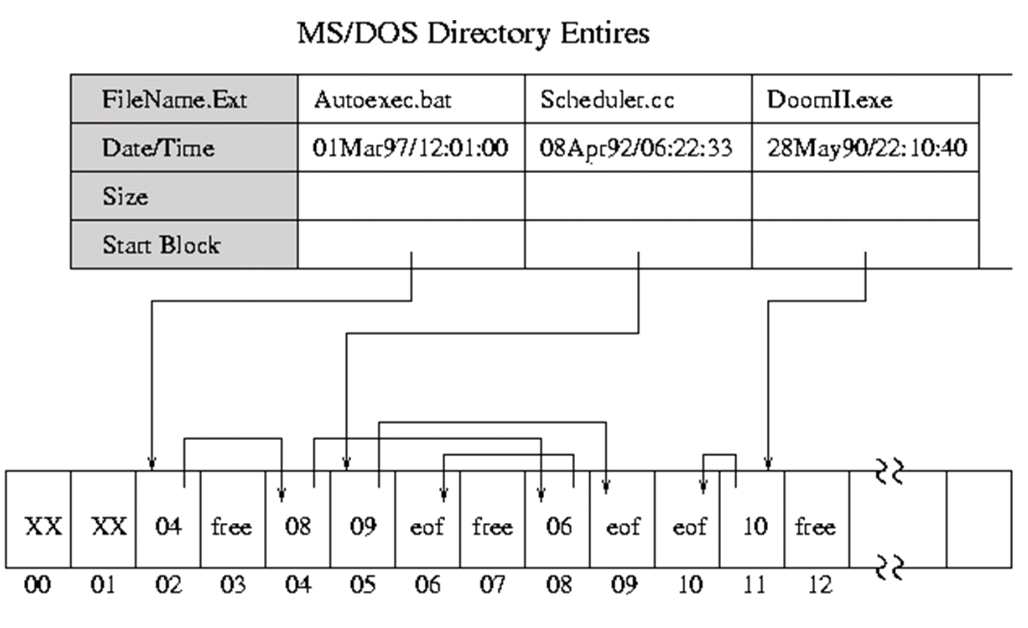
Example - File Allocation Table
FAT

Slide 32
Relational DB
Data is held in tables
Relationship between data is contained in common values between tables.

Slide 33
Parts Table

Slide 34
Parts Table
Projects Table

Slide 35
Parts Table
Link??
Projects Table

Slide 36
Parts Table
Parts_Required Table
Projects Table

Slide 37
Parts Table
Parts_Required Table
Projects Table

Slide 38
Self Test Questions
Describe 2 models for data storage. Give examples to illustrate each.
In the Projects and parts database discussed in class – add in a new project managed by Bob in limerick which requires 1000 nuts and bolts and 200 clips (part nr 16, weight 30grms) – draw the final Database using 3 different DB models

